Slide 1
Asterids
(Sympetalae= flowers with fused petals)
Judd et al. pp. 465-549

Slide 2
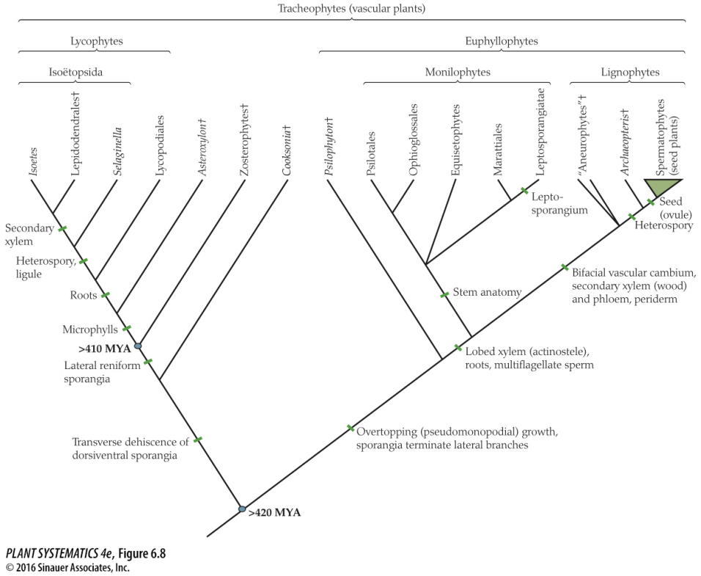
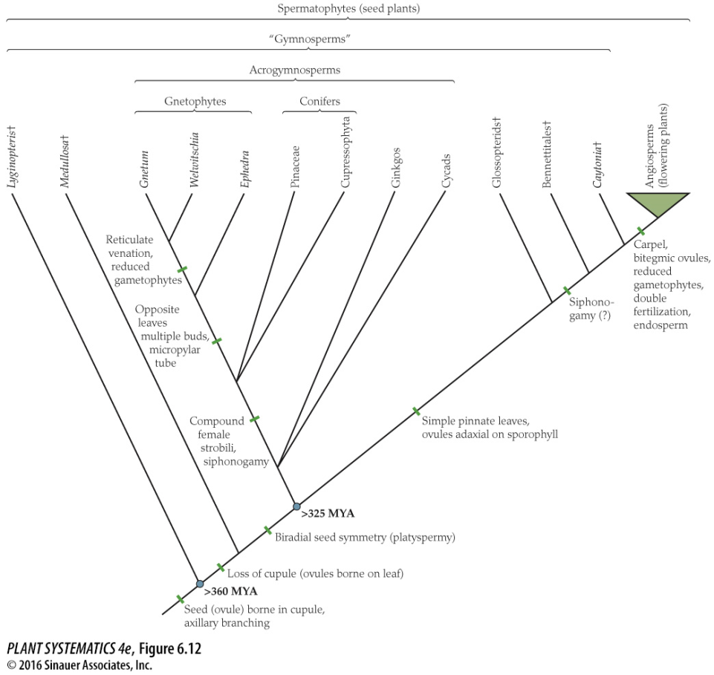
Remember the really big picture…
Mosses, Liverworts, Hornworts
Algae

Slide 3
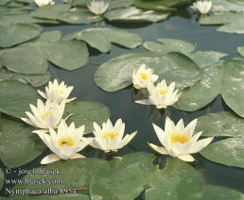
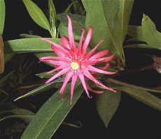
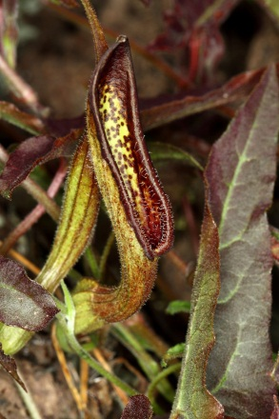
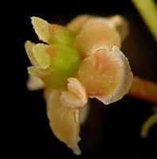
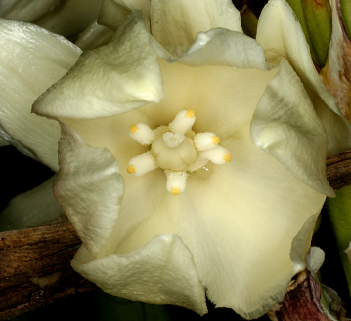
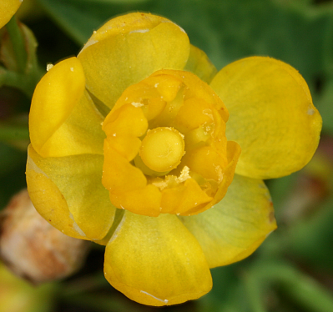
Magnoliids
Monocots
Amborella
Nymphaeales
Austrobaileyales
ANA Grade
Remember the big picture….
Eudicots
Angiosperm Relationships (new)
(simplified)

Slide 4
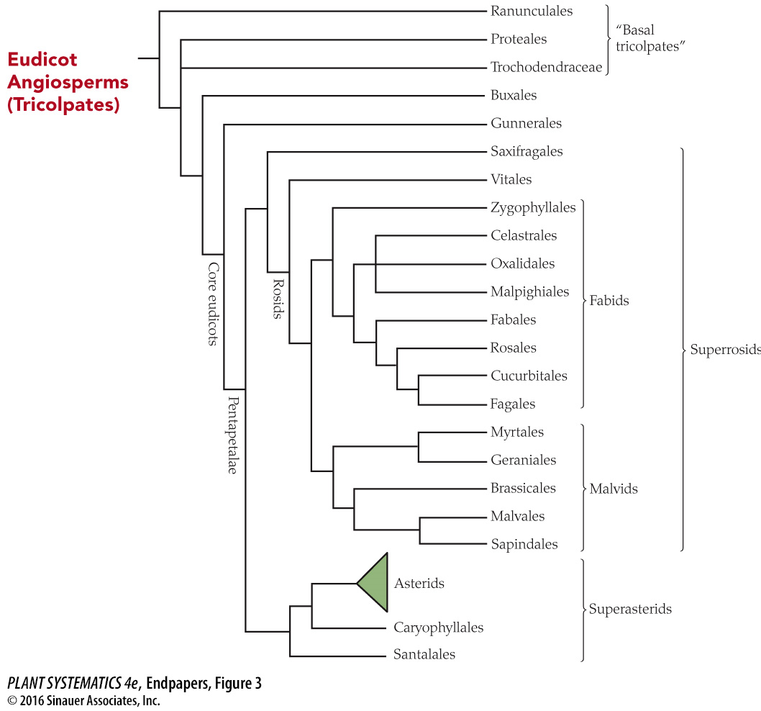
Core Eudicots are a clade supported by rbcL, atpB, matK and 18S sequences.
(matK encodes a protein that helps with intron removal that separates the coding regions of trnK)
You are here!

Slide 5
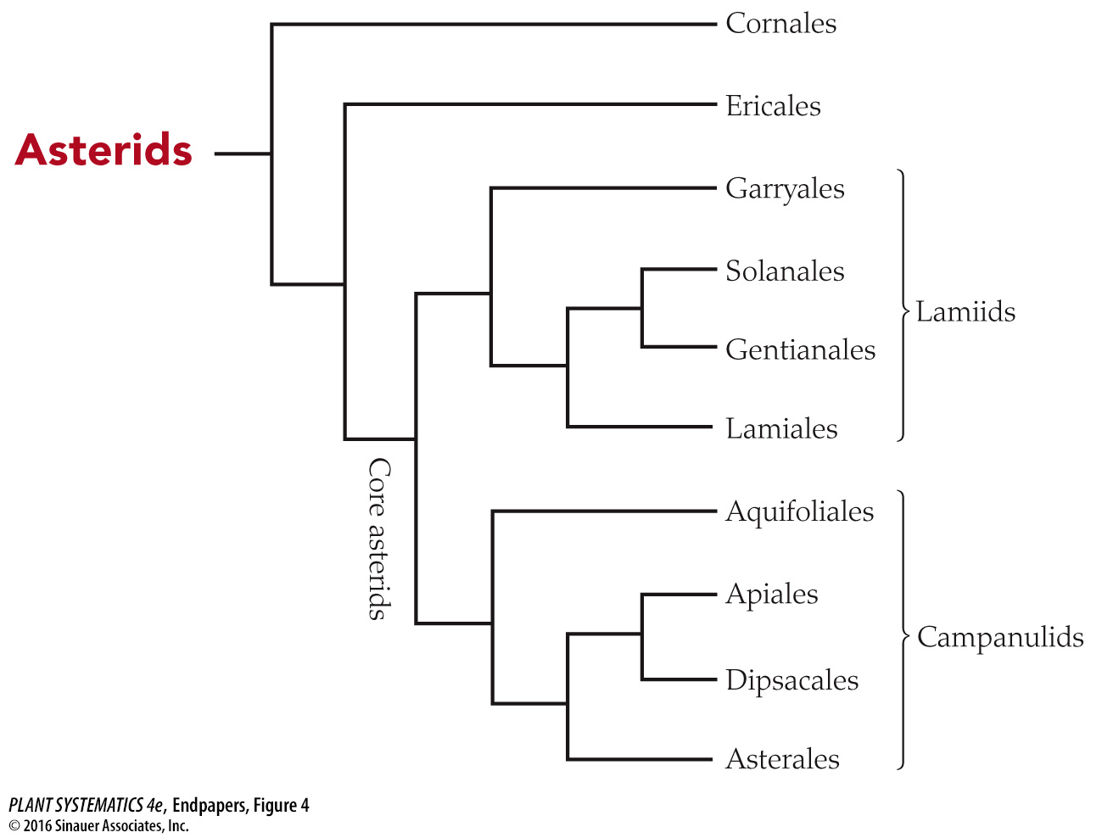

Slide 6
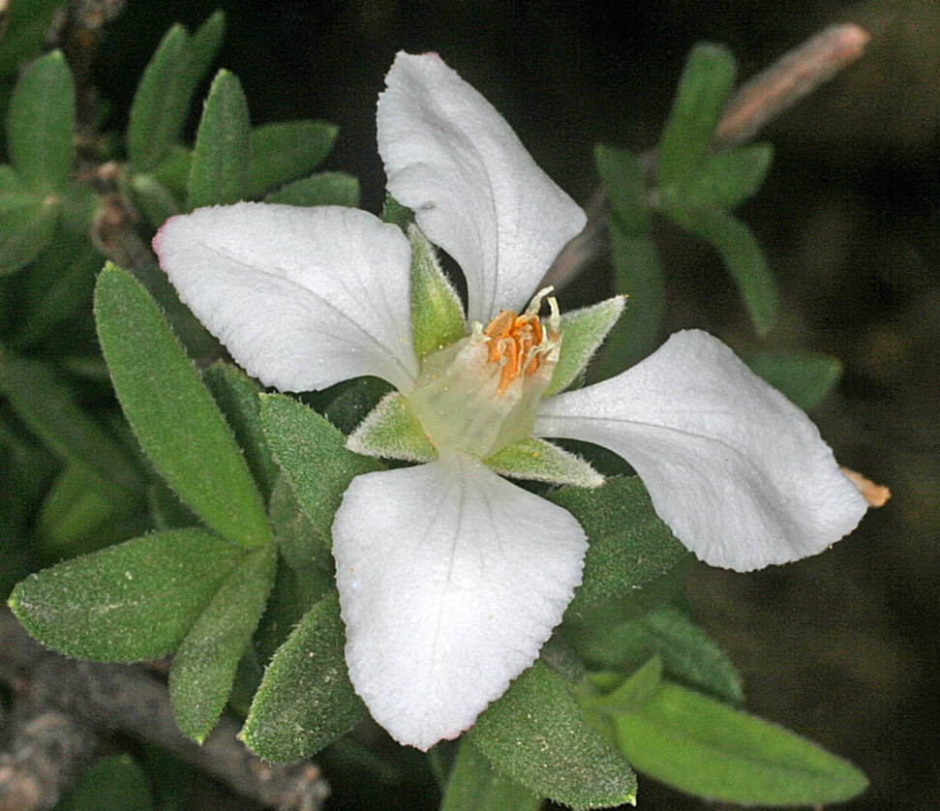
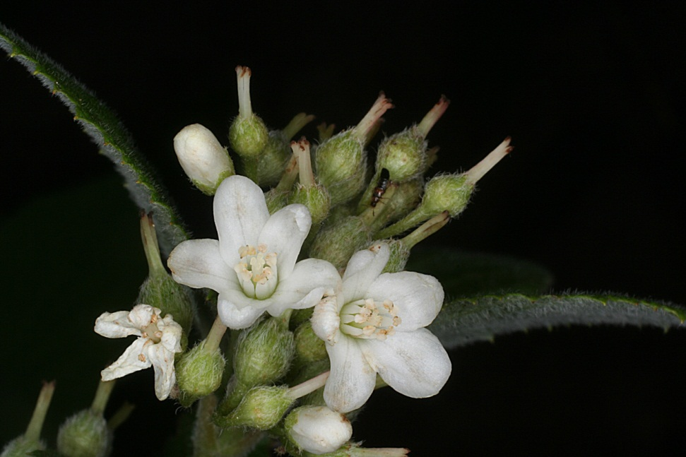
Eudicots: Asterids: Cornales
(Loasaceae, Hydrangeaceae, Cornaceae)
Hydrangeaceae: Fendlera rupicola
Hydrangeaceae: Jamesia americana
Hydrangeaceae: 4 or 5 distinct petals, filaments slightly connate, ovary inferior

Slide 7
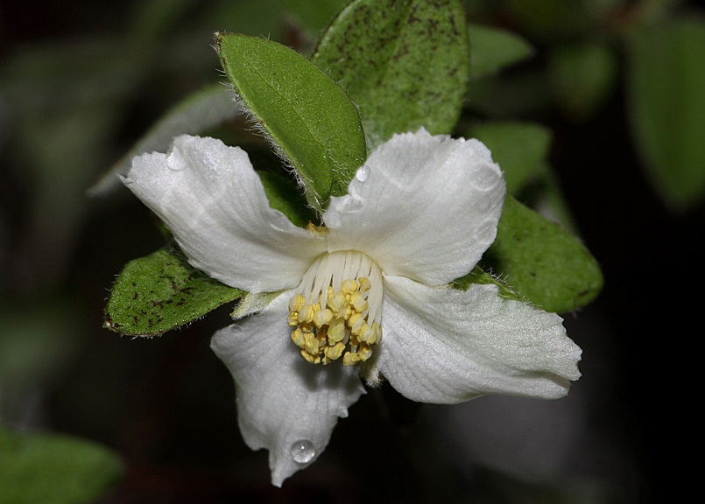
Eudicots: Asterids: Cornales
Hydrangeaceae: Philadelphus microphyllus
Similar to Fendlera, but many more stamens and petals not clawed

Slide 8
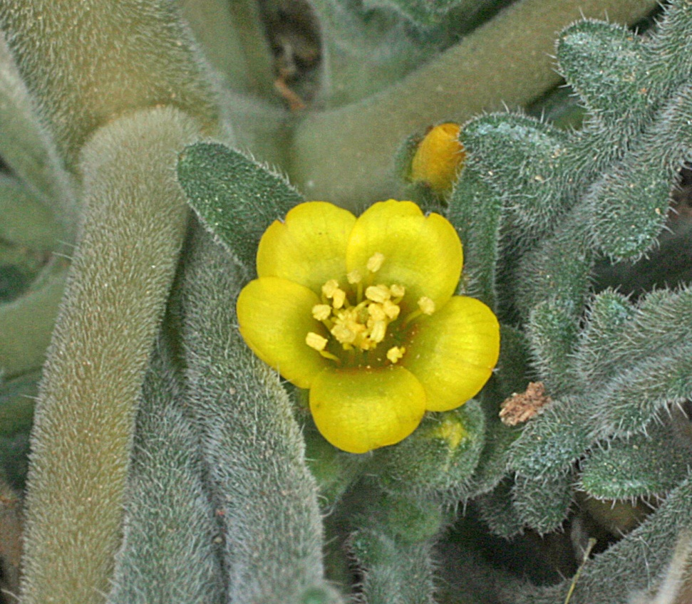
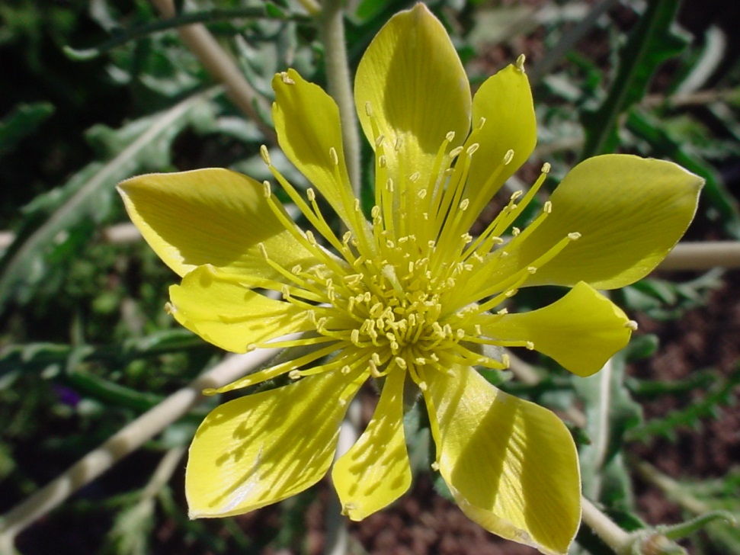
Eudicots: Asterids: Cornales
Loasaceae: Mentzelia longiloba
Loasaceae: Mentzelia albicaulis
5 sepals, 5 petals, 5 petaloid staminodes and many stamens

Slide 9
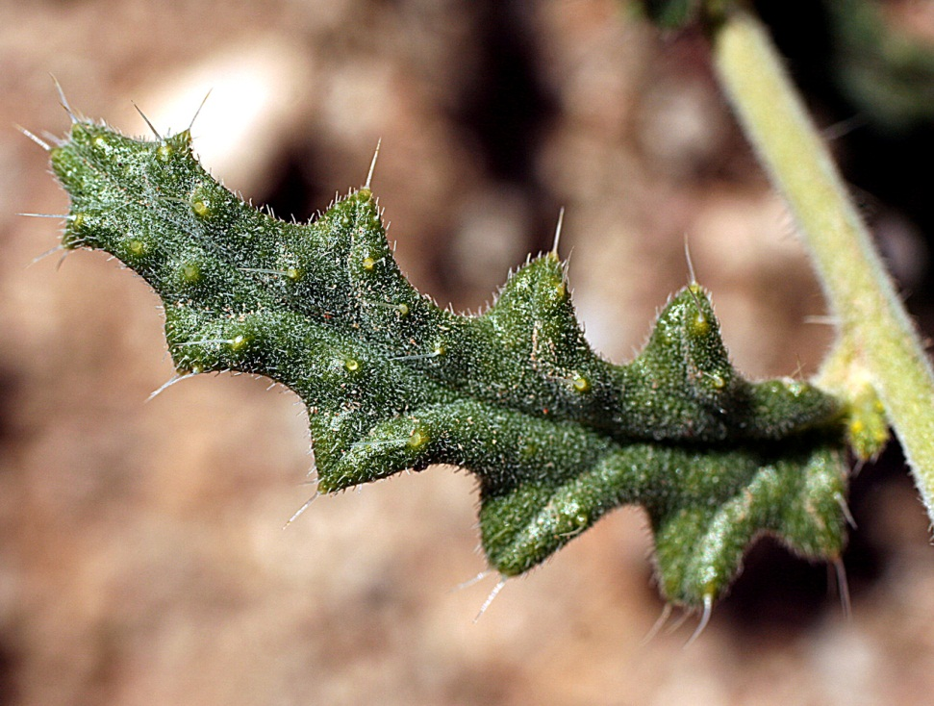
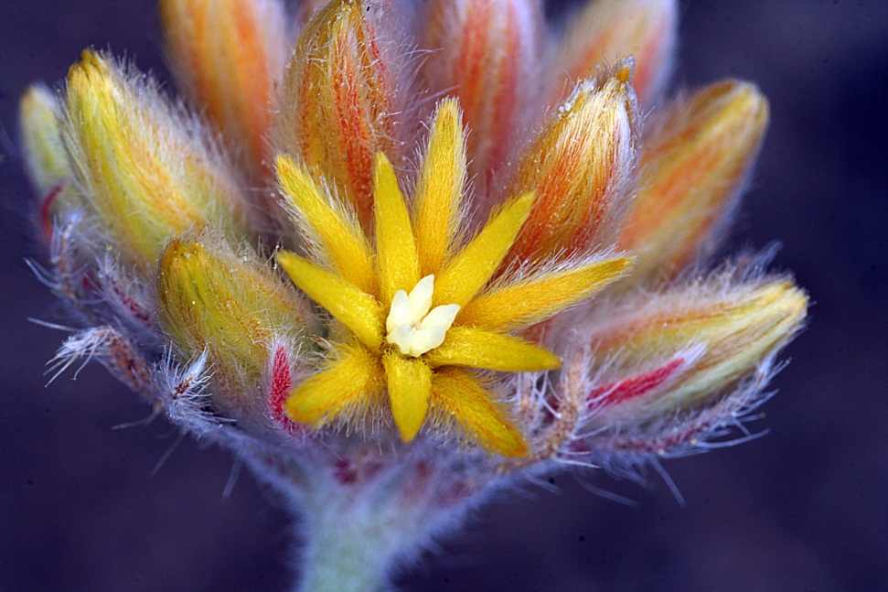
Eudicots: Asterids: Cornales
Loasaceae: Cevallia sinuata (flowers)
Loasaceae: Cevallia sinuata (leaf)
Stinging Serpent: an armed desert dweller.

Slide 10
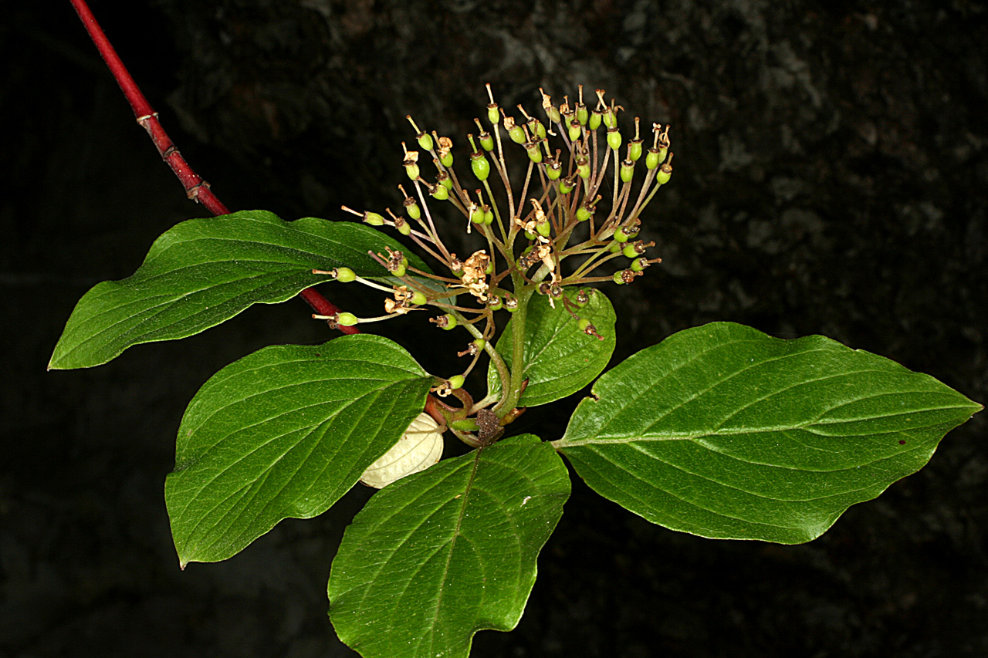
Eudicots: Asterids: Cornales: Cornus sericea
Red Osier Dogwood. An osier is a twig.

Slide 11
The Asterids are also known as the Sympetalae: the core asterids have an obviously sympetalous corolla.
Ericales and Cornales progressively sister groups to Core Asterids, and not necessarily sympetalous

Slide 12
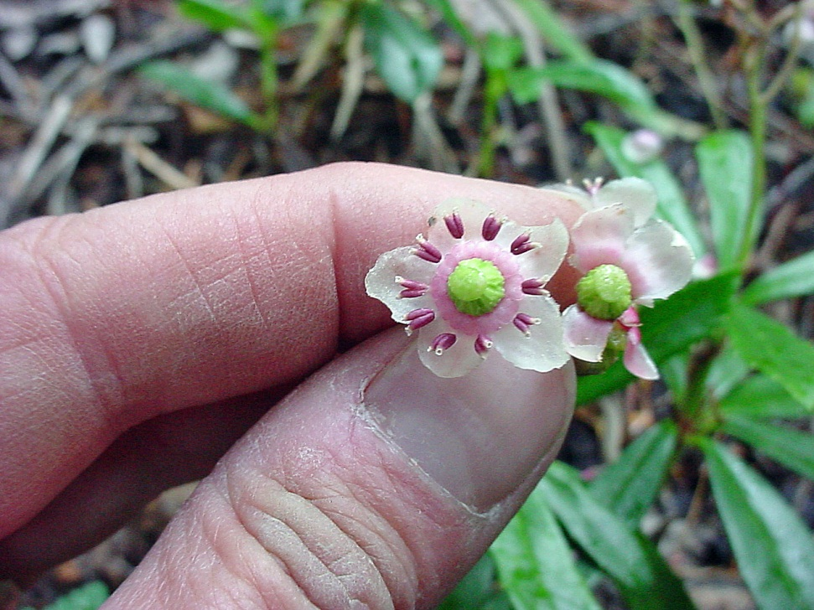
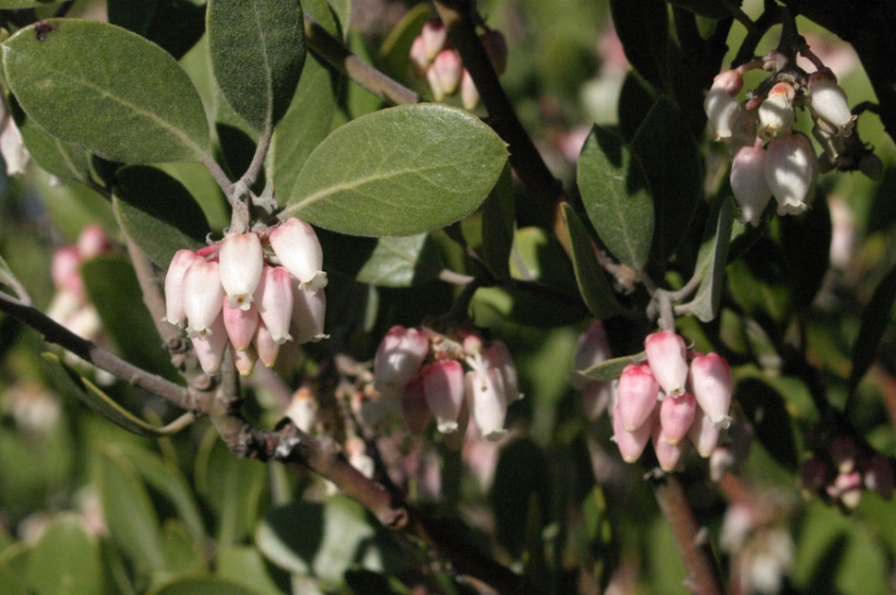
Eudicots: Asterids: Ericales: Ericaceae
Arctostaphylos pungens
Chimaphila umbellata
Sympetalous, pendulous flowers
Stamens open by terminal pores: like Solanum species.

Slide 13
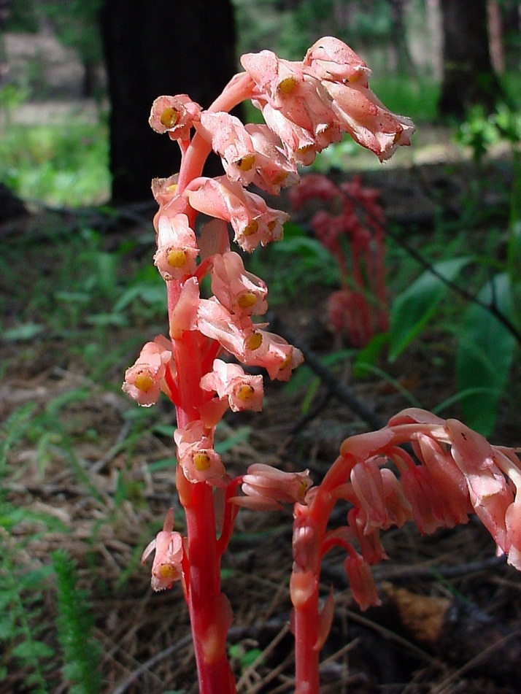
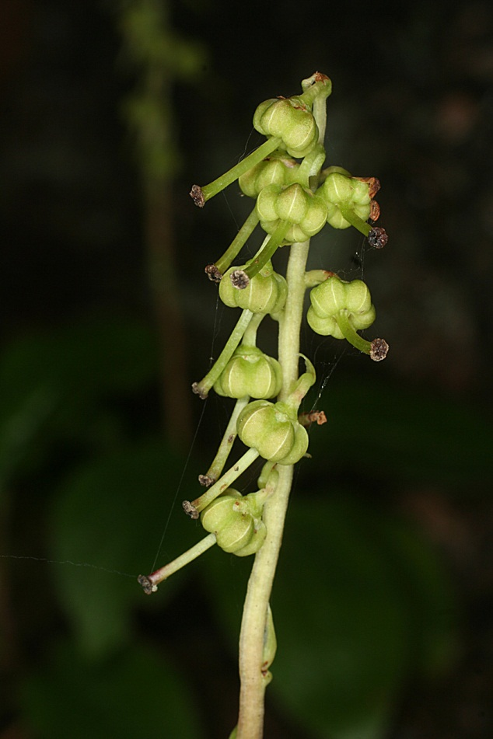
Eudicots: Asterids: Ericales: Ericaceae
Monotropa hypopitys
Orthilia secunda
This family is well represented in the Gila, but the Northeast US has many more heaths.

Slide 14
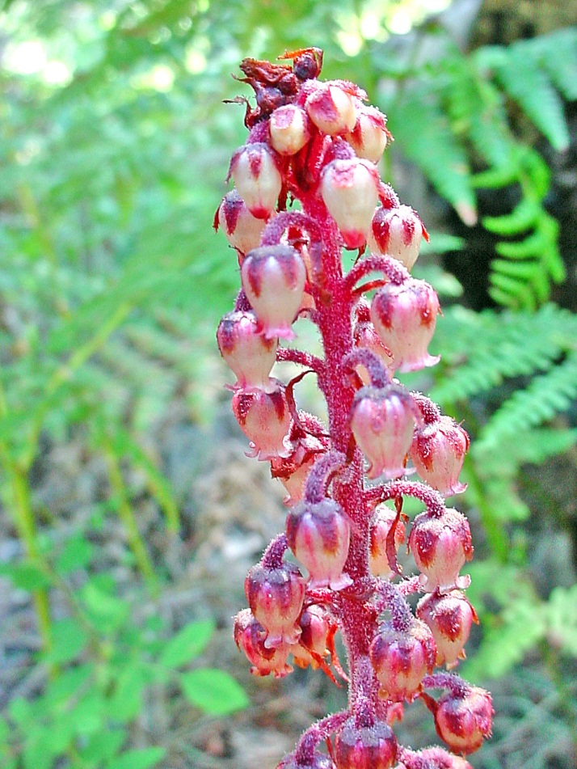
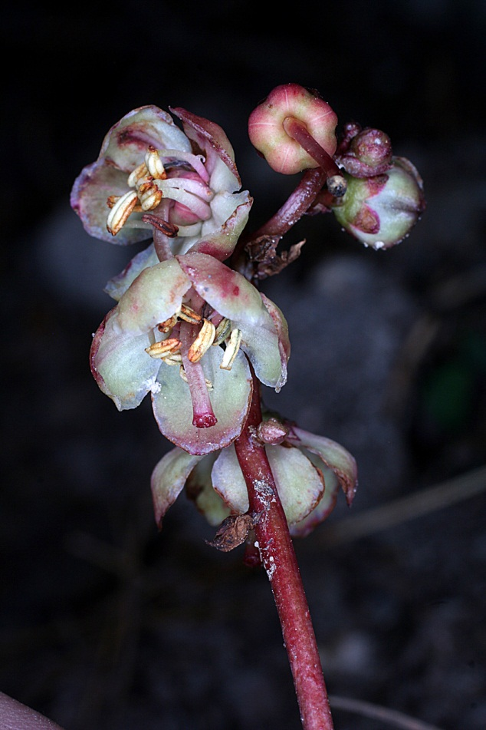
Eudicots: Asterids: Ericales: Ericaceae
Pterospora andromedea
Pyrola picta

Slide 15
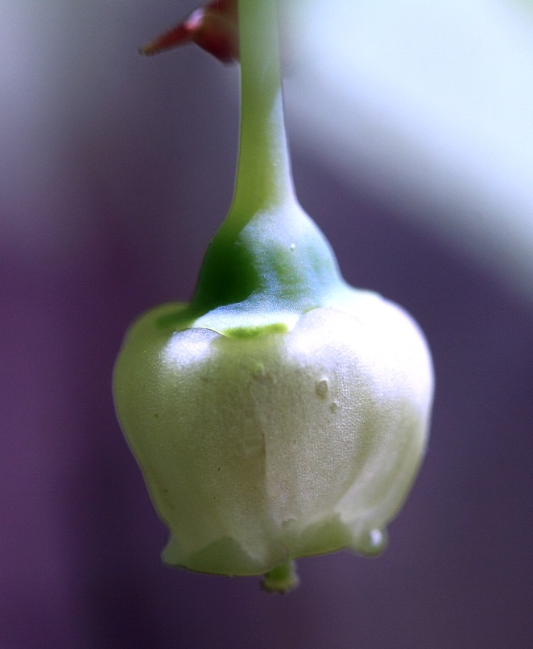
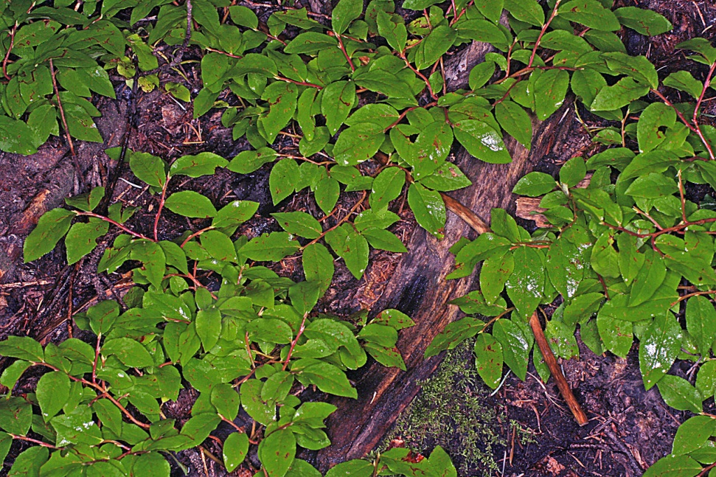
Eudicots: Asterids: Ericales: Ericaceae
Vaccinium myrtillus
Vaccinium myrtillus
Rhizomatous, with angled branches; Whortleberry.

Slide 16
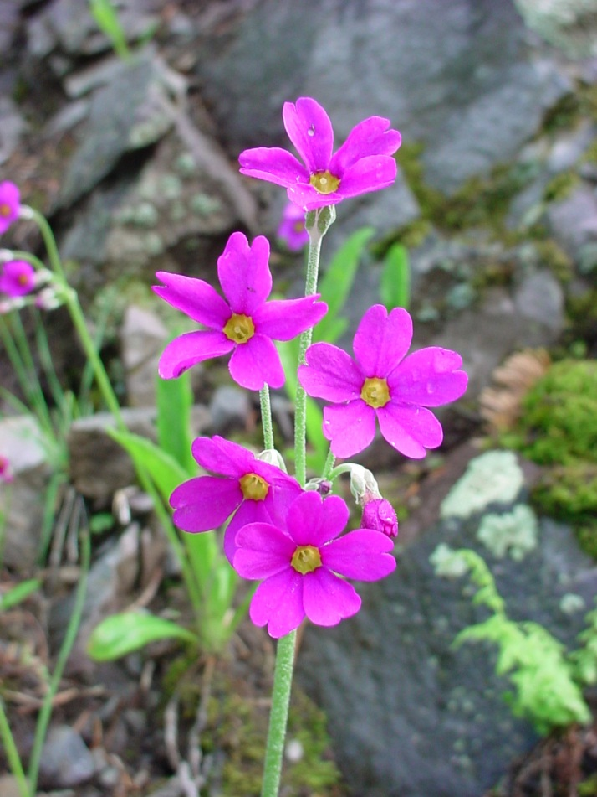
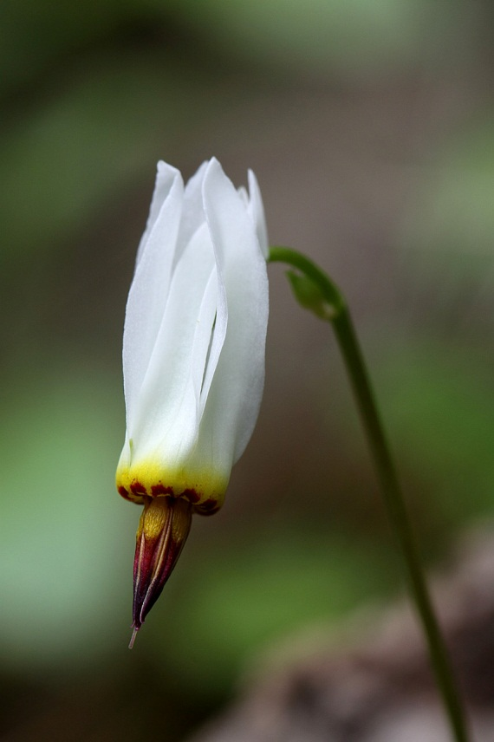
Eudicots: Asterids: Ericales: Primulaceae
Primula rusbyi
Primula standleyana
Has secretory cavities containing yellow and red materials on floral parts

Slide 17
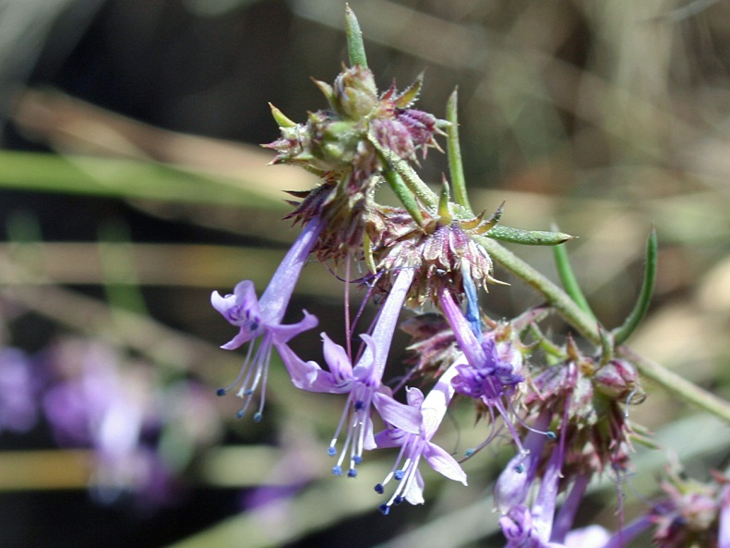
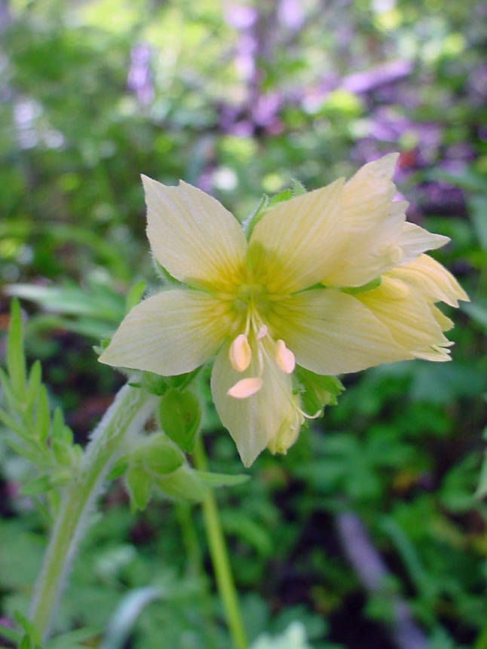
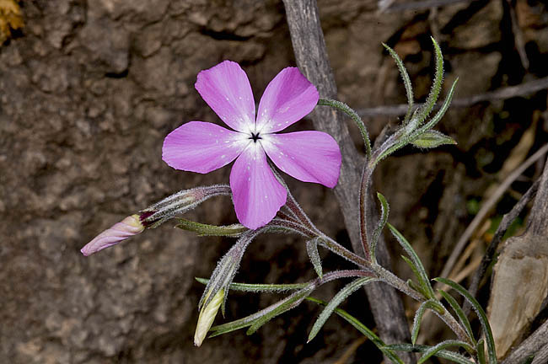
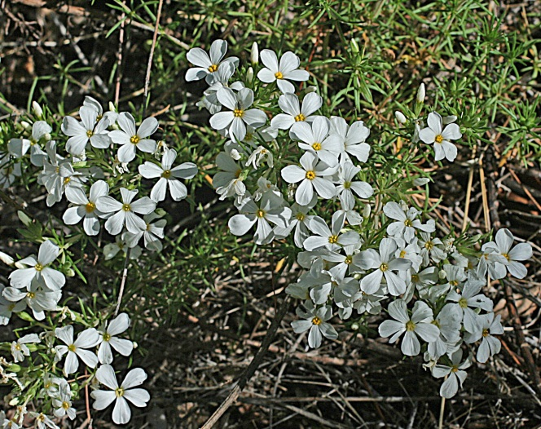
Eudicots: Asterids: Ericales: Polemoniaceae
Ipomopsis macombii
Polemonium flavum
Phlox triovulata
Leptosiphon nuttallii

Slide 18
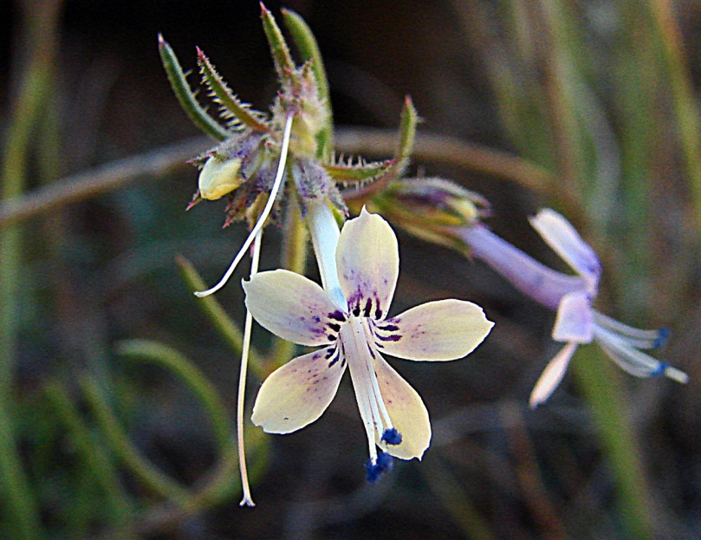
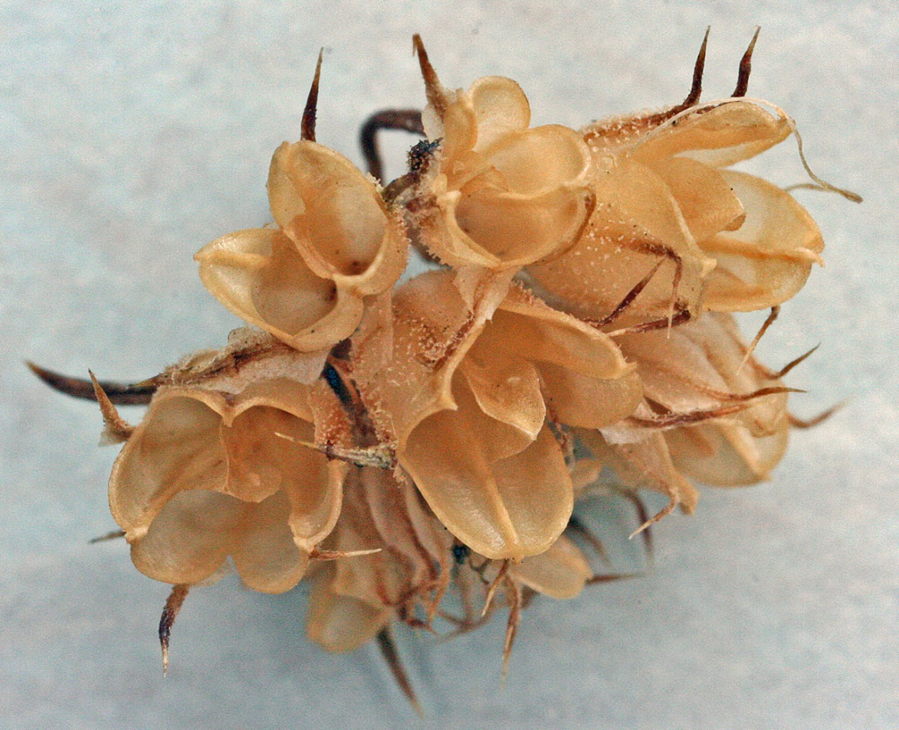
Eudicots: Asterids: Ericales: Polemoniaceae: Ipomopsis macombii
5 connate sepals, 5 connate petals.
Three carpels, fruit a capsule.

Slide 19
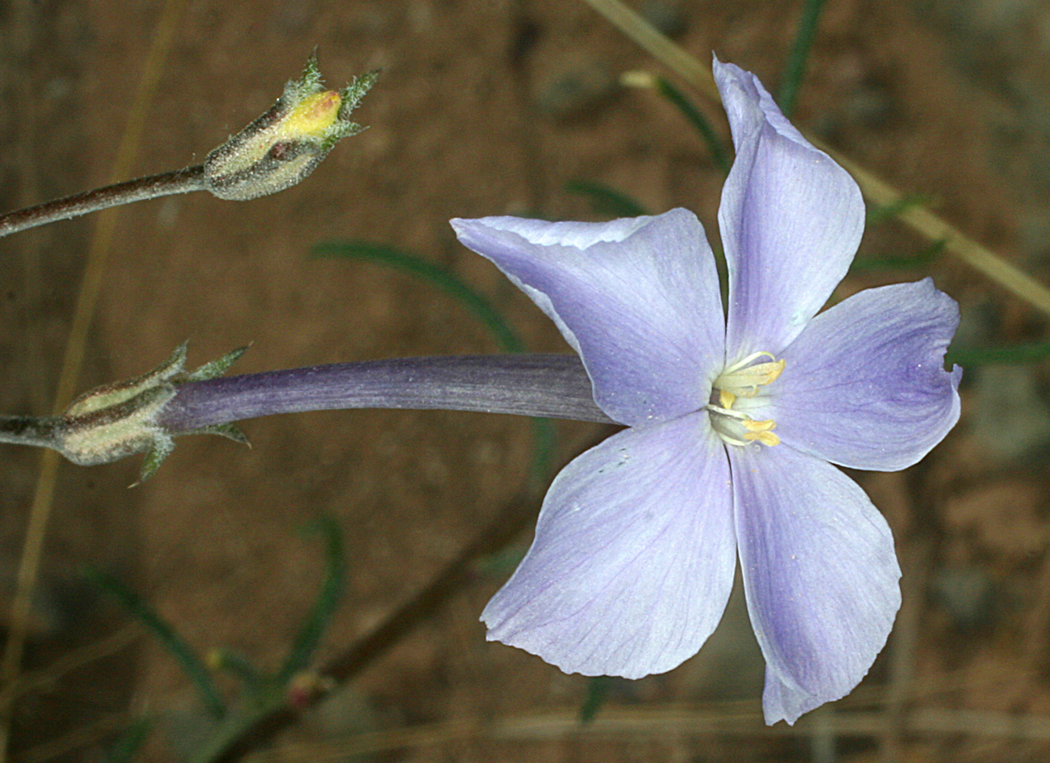
Eudicots: Asterids: Ericales: Polemoniaceae: Ipomopsis longiflora
5 connate petals forming a long narrow tube; 5 connate sepals; ovary superior with 3 carpels

Slide 20
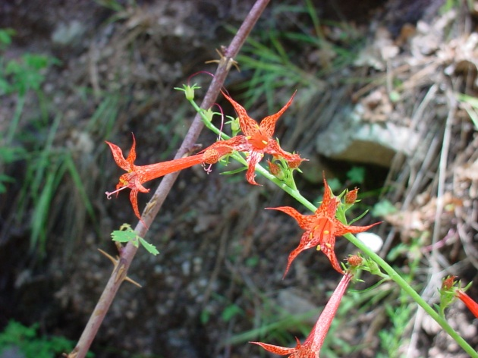
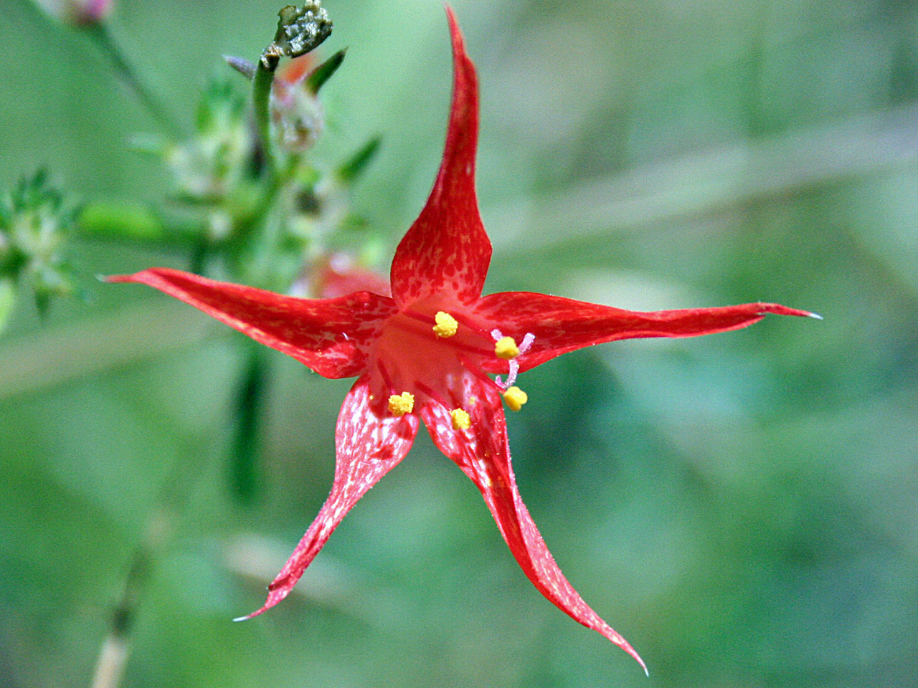
Eudicots: Asterids: Ericales: Polemoniaceae: Ipomopsis aggregata
5 stamens, 3 carpels, 5 petals connate into a long, narrow tube

Slide 21
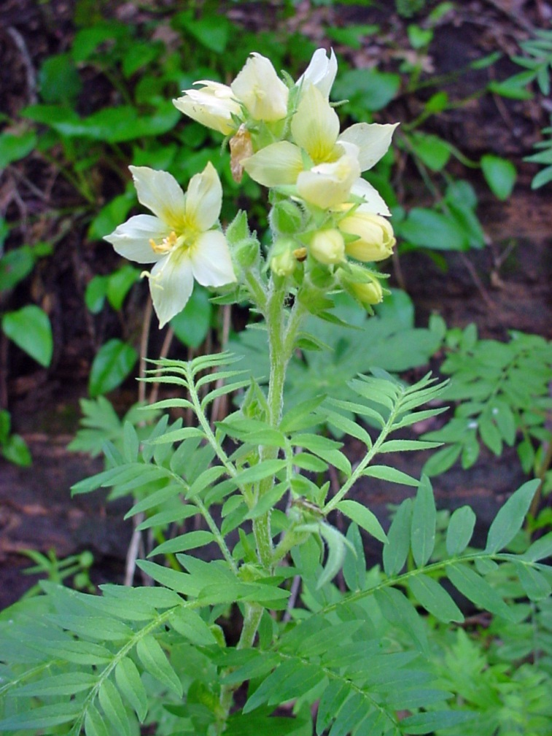
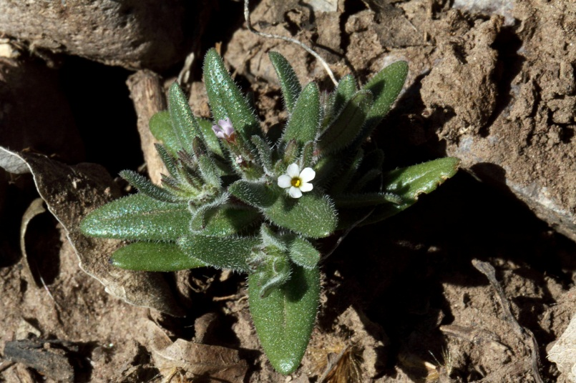
Eudicots: Asterids: Ericales: Polemoniaceae
Foliage is variable
Microsteris gracilis: simple leaves
Phlox triovulata: deeply dissected leaves
Polemonium flavum, leaves compound

Slide 22
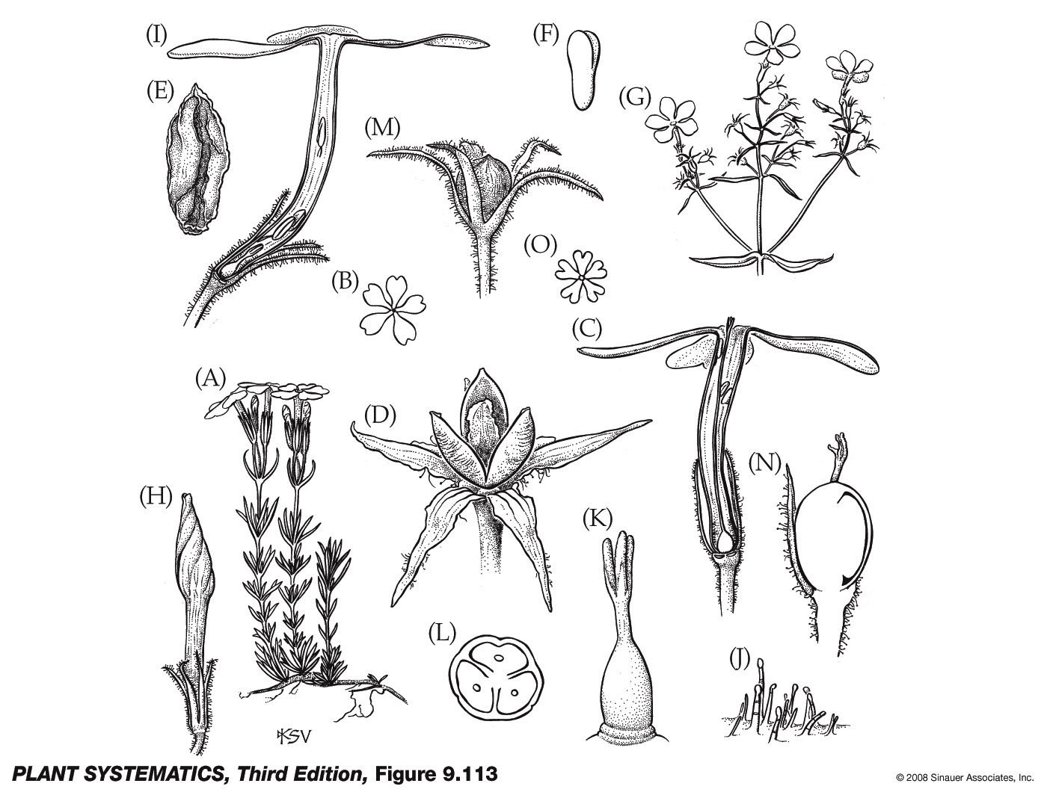
Phlox nivalis from J&C: superior ovary with 3 carpels

Slide 23
Eudicots: Asterids: Polemoniaceae
Foliage—
Calyx—
Corolla—
Androecium—
Gynoecium—
Fruit—
variable
5 connate sepals
5 petals connate and often forming a narrow tube
5 distinct stamens
3 connate carpels, superior ovary
Loculidical capsule

Slide 24
The Asterids are also known as the Sympetalae: the core asterids have an obviously sympetalous corolla.
Ericales and Cornales progressively sister groups to Core Asterids, and not necessarily sympetalous

Slide 25
Core Asterids
(possible synapomorphies)
Obviously sympetalous corolla
Number of stamens equals number of petals, usually (but not in Lamiaceae…)
Epipetalous stamens (stamens adnate to the corolla)
Usually 2 fused carpels
DNA sequences

Slide 26
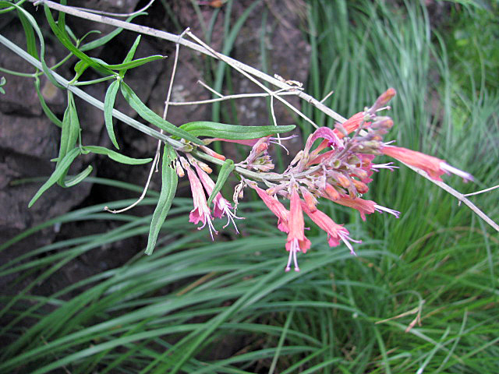
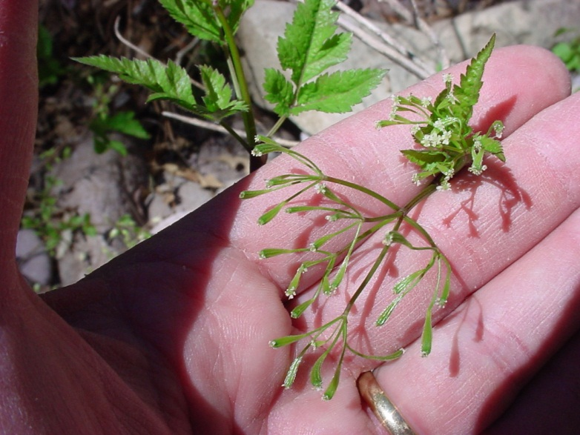
Core Asterids
Lamiids
Campanuliids
Opposite leaves
Hypogynous perianth (superior ovary)
Alternate leaves
Epigynous perianth (inferior ovary)
Agastache rupestris
Osmorhiza depauperata

Slide 27
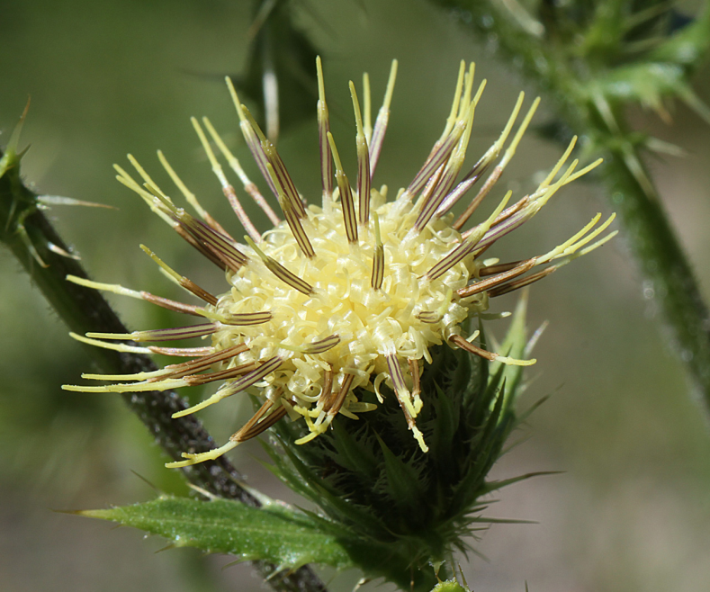
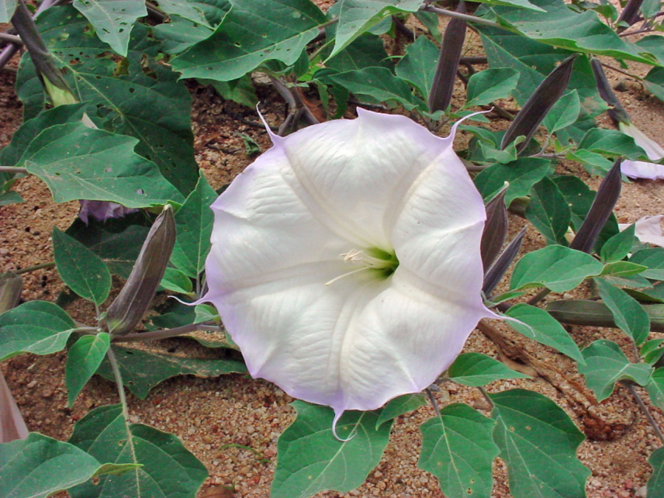
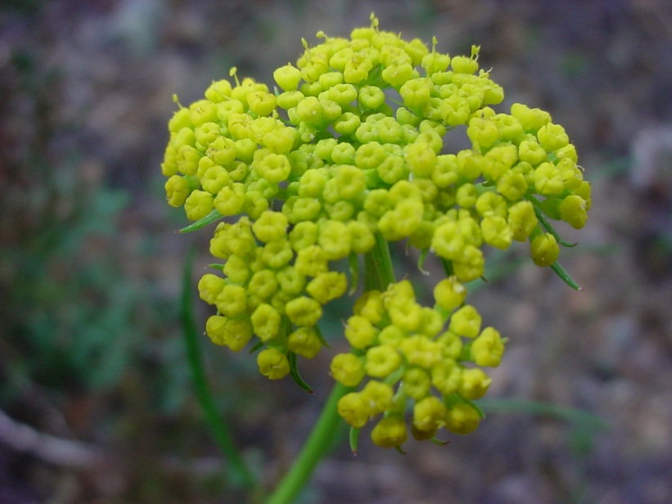
Core Asterids
Cirsium gilense (Asterales)
Datura wrightii (Solanales)
Cymopterus lemmonii (Apiales)

Slide 28
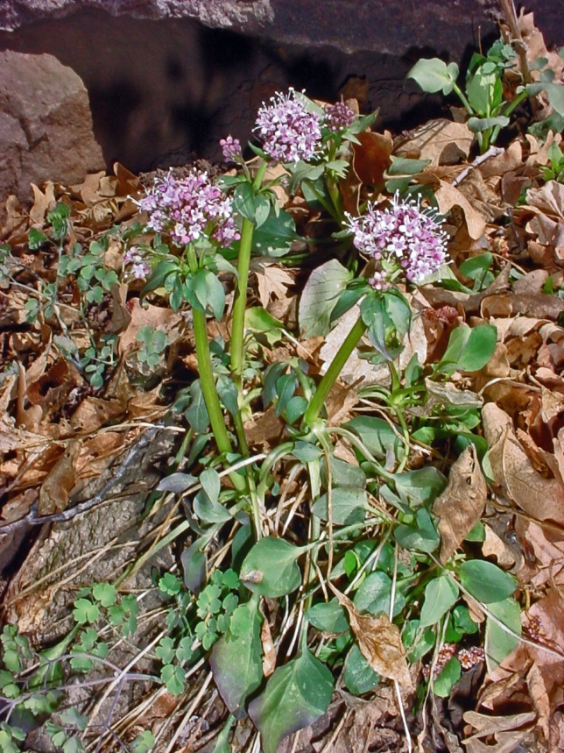
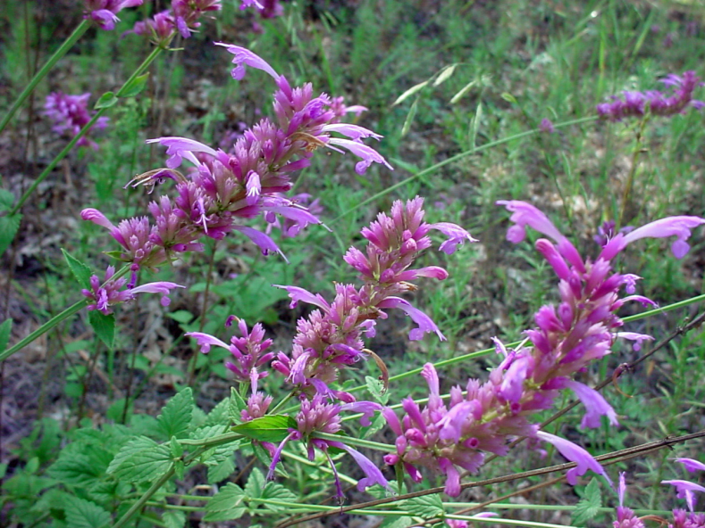
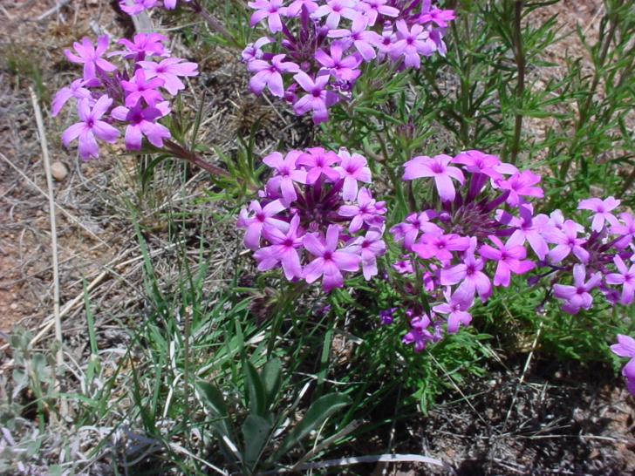
Core Asterids
Valeriana arizonica (Caprifoliaceae, Dipsacales)
Glandularia bipinnitifida (Lamiales)
Agastache neomexicana (Lamiales)

Slide 29
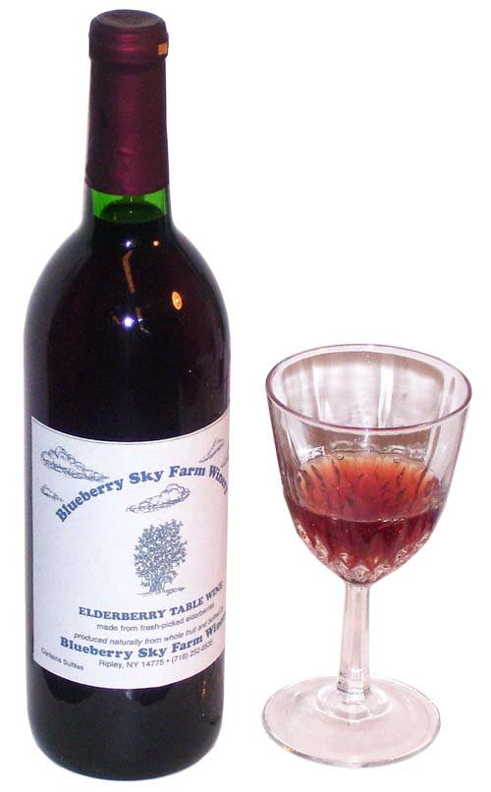
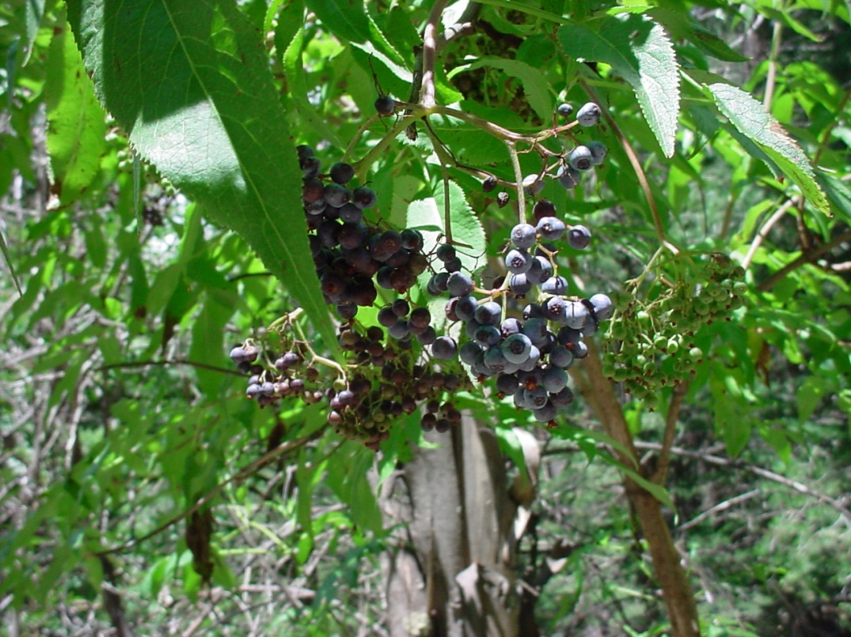
Core Asterids
Sambucus coerulea (Adoxaceae, Dipsacales, Campanulid)
But… Vitales are Rosids!

Slide 30





Core Asterids
Convolvulaceae
Ipomoea battatus= sweet potato
Lamiaceae
Apiaceae
Rubiaceae

Slide 31

Core Asterids
Core Asterids: Asteraceae: Lactuca sativa (Iceberg Lettuce) Core Asterids

Slide 32



Eudicots: Asterids: Lamiids: Garryaceae: Garrya wrightii

Slide 33
Phylogenetic Relationships within Asterids

Slide 34


Lamiids
Solanales
Gentianales
Boraginaceae
Convolvulaceae
Solanaceae
Rubiaceae
Apocynaceae
Gentianaceae
Cuscuta sp.

Slide 35


Lamiids
Lamiales
Acanthaceae
Oleaceae
Plantaginaceae
Scrophulariaceae
Orobanchaceae
Bignoniaceae
Lamiaceae
Verbenaceae
Orobanche ludoviciana
Anisacanthus thurberi

Slide 36





Eudicots: Asterids: Lamiids:
SOLANACEAE
Physalis (Tomatillo)
Capsicum (Pepper)
Solanum (Eggplant)
Solanum (Potato)
Lycopersicon (Tomato)

Slide 37

Eudicots: Asterids: Lamiids: Solanaceae
Alkaloids present– most are poisonous!

Slide 38




Eudicots: Asterids: Lamiids: Solanaceae
Alkaloids are present– most are poisonous!
Tobacco– from plants of the genus Nicotiana

Slide 39




Eudicots: Asterids: Lamiids: Solanaceae
Flowers
Datura wrightii
Solanum elaeagnifolium
Physalis foetans
Lycium pallidum

Slide 40


Eudicots: Asterids: Lamiids: Solanaceae
Solanum elaeagnifolium– anthers open by terminal pores

Slide 41

Eudicots: Asterids: Lamiids: Solanaceae
Solanum elaeagnifolium: 2 connate carpels

Slide 42


Eudicots: Asterids: Lamiids: Solanaceae
Fruit
Datura quercifolia– capsule
Lycium pallidum– a berry

Slide 43


Slide 44
Eudicots: Asterids: Lamiids: Solanaceae
Foliage–
Calyx–
Corolla–
Androecium–
Gynoecium–
Fruit–
alkaloids present, frequently poisonous
usually 5, connate
usually 5, connate and plicate
usually 5 stamens adnate to corolla, anthers opening by slits or pores
Two carpels connate, ovary superior
berry or capsule

Slide 45
Phylogenetic Relationships within Asterids

Slide 46



Eudicots: Asterids: Lamiids: Lamiaceae
Monarda pectinata
Marrubium vulgare
Salvia henryi

Slide 47








LAMIACEAE
Rosmarinus
Origanum
Ocimum
Mentha

Slide 48


Eudicots: Asterids: Lamiids: Lamicaceae
Fruit: 4 nutlets

Slide 49

Eudicots: Asterids: Lamiids: Lamiaceae
5 connate sepals
5 connate petals
2 lipped
Style and stamens under upper lip
Stachys coccinea
Salverform corolla (and not funnelform)

Slide 50

Eudicots: Asterids: Lamiids: Lamiaceae
Marrubium vulgare stem cross sections

Slide 51
Eudicots: Asterids: Lamiids: Lamiaceae
Foliage–
Calyx–
Corolla–
Androecium–
Gynoecium–
Fruit–
stems often (but not always) square in cross section; hairs gland-headed with ethereal oils; leaves usually opposite
5 connate sepals
5 connate petals
usually 4 stamens, adnate to corolla
2 connate carpels (each carpel with a false septum so appearing as 4 locules)
schizocarp with 4 nutlets

Slide 52


Slide 53


Eudicots: Asterids: Lamiids: Gentianaceae
Frasera speciosa
Frasera speciosa
Poster child for a superior ovary! Nectar glands on adaxial surface.

Slide 54


Eudicots: Asterids: Lamiids: Gentianaceae
Zeltnera calycosa
Halenia rothrockii

Slide 55




Eudicots: Asterids: Lamiids: Rubiaceae
Crusea diversifolia
Galium fendleri

Slide 56


Eudicots: Asterids: Lamiids: Rubiaceae: Houstonia wrightii
Inferior ovary, 2 connate carpels

Slide 57


Eudicots: Asterids: Lamiids: Convolvulaceae
Ipomoea cristulata
Ipomoea hederacea

Slide 58


Eudicots: Asterids: Lamiids: Convolvulaceae
Evolvulus sericeus
Dichondra brachypoda
Hey! This is NOT a GRASS!!!!

